Slide 1
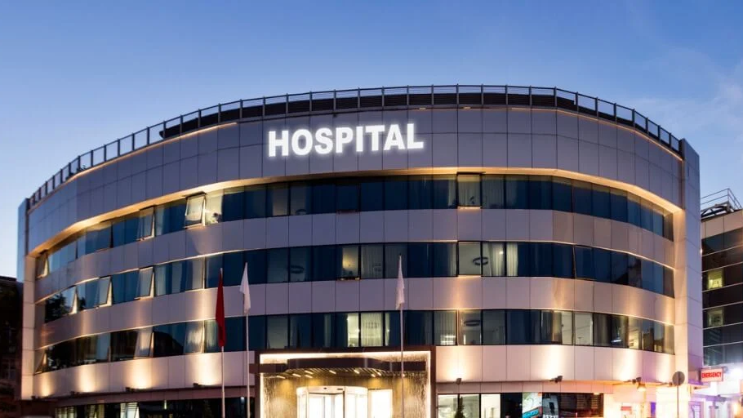
Lake ridge community hospital (LRCH) advancement proposal
Addan zahra, neilavan Vijayakanthan, Manu Sugunakumar, Himanshu

Slide 2
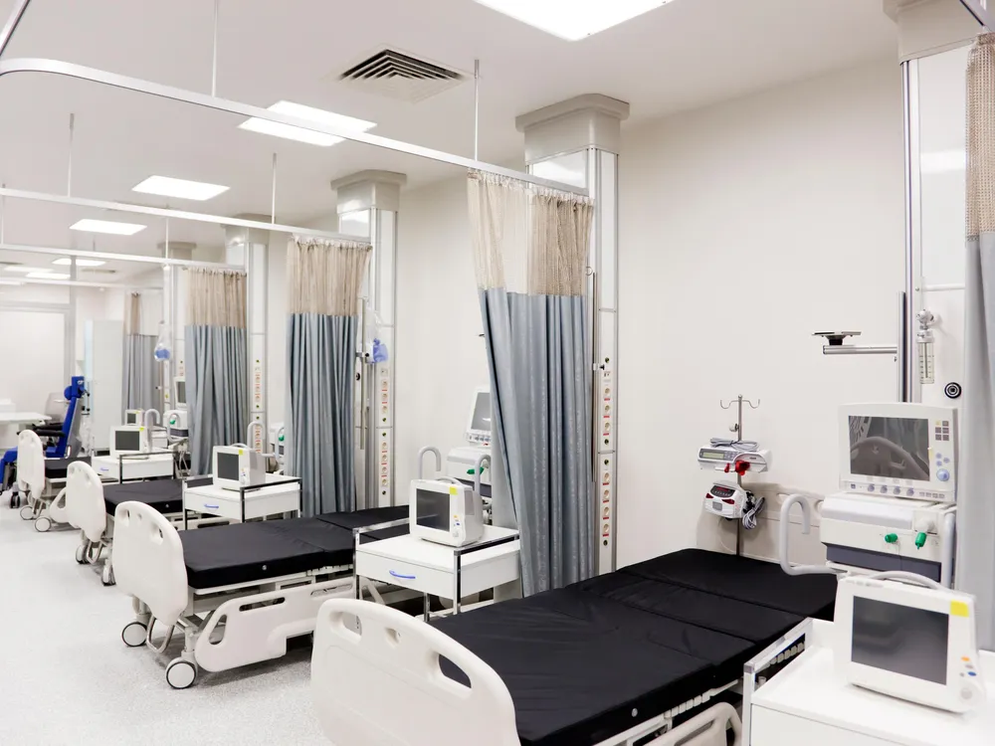
Introduction
Lake Ridge Community Hospital (LRCH) is facing challenges with their existing information systems.
They aim to expand its capacity from 100 to 200 beds to accommodate a growing community of nearly 400,000 people.
The hospital is divided into two groups, physicians, and administrators.

Slide 3


The existing challenges
LRCH faces obstacles with current batch-oriented information systems, hindering efficient medical staff support, treatment recommendations, system-wide access speed, cost tracking, and adaptability to changing needs.
Key Requirements:
- Patient and physician management
- Physician-patient reporting
- Revenue management
- Room utilization
- Patient billing
- Database design
- Development SQL queries

Slide 4
Mission statement
“Our goal in building the database for Lake Ridge Community Hospital is to provide a strong and effective information system that supports the hospital's dedication to excellence, empowers medical staff, and improves patient care. Our mission is to provide a database system that effortlessly combines information from different medical departments while maintaining accuracy, usability, and security.”

Slide 5
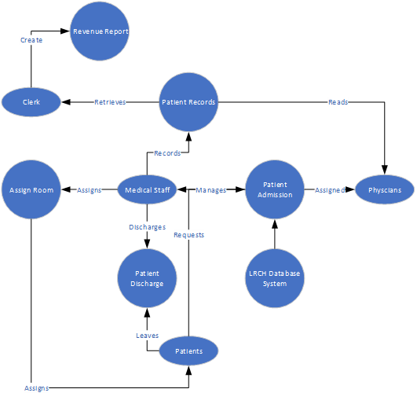
LEVEL 0 DATA-FLOW DIAGRAM
Notes:
A Level 0 Data Flow Diagram (DFD) for Lake Ridge Community Hospital (LRCH) would provide an overview of the major processes and data flows within the hospital's information system. At this level, the diagram focuses on high-level processes and their interactions with external entities.

Slide 6
LEVEL 1 DATA-FLOW DIAGRAM

Slide 7
Functional requirements
Bed and Room Status
Weekly Financial Report
Billing Statement Generation
Balance Calculation
Record Retention
Archiving Policy
User Authentication and Authorization
Treatment Recording
Cost Center Linkage
Occupancy Overview
- Data Input and Modification
- Data Amendments and History
- Physician Database
- Patient-Physician Association
- Customized Daily Reports
- Patient Specifics
- Reporting and Recording
- Prescription Records
- Transaction Records
- Revenue Monitoring

Slide 8

NON-FUNCTIONAL REQUIRMENTS
Data Integrity
Concurrency Control
Data Recovery Time
Database Backup Frequency
User Permission
Data Accessibility
User Feedback and Satisfaction
Healthcare Data Privacy
Rela-Time Updates
Data Retrieval
Audit Trail
Performance
Security
Reliability
Usability
Scalability
Compatibility
Regulatory Compliance
Reporting
Data Archiving and Retention
Resource Utilization
Change Management

Slide 9
Entity relationship diagram

Slide 10
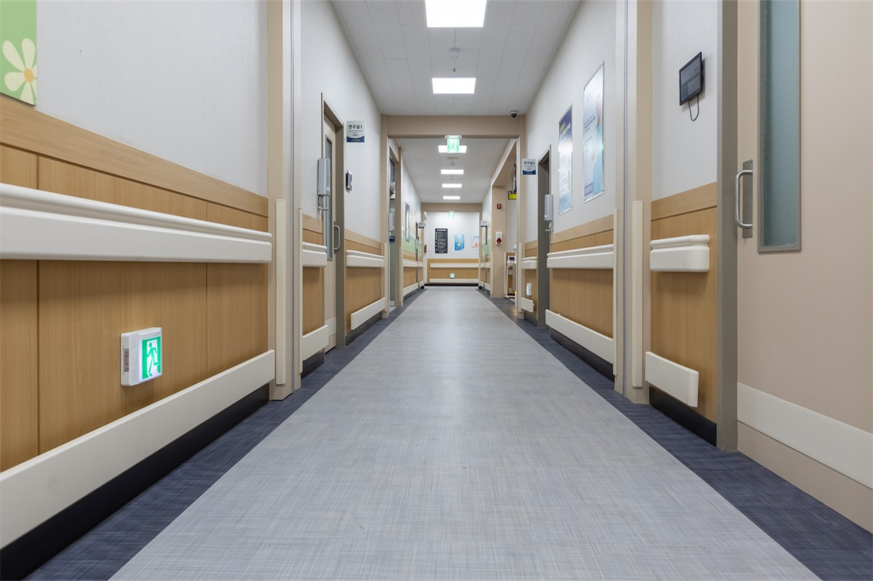
Walk-through of Database

Slide 11

ROOM UTILIZATION REPORT Demonstration

Slide 12
Thank you!
We hope you take this into consideration, and it aids in solving your challenges faced at LRCH

Slide 13
Image sources:
https://www.smithsonianmag.com/history/when-fresh-air-went-out-fashion-hospitals-180963710/
https://www.partnermd.com/blog/hospital-admitting-privileges
https://www.iconfinder.com/icons/3746511/data_database_healthcare_hospital_medical_records_icon
https://www.geminimedicine.ca/data
https://pixabay.com/photos/hallway-hospital-clean-rooms-doors-5979689/

